Slide 1
JAVA Programming
Course Instructor: Dr. Suvojit Dhara
School of Computer Science
UPES Dehradun

Slide 2
TOPICs to be discussed
Constructors in Java
Default constructors
Parameterized constructors
Constructor Overloading
Copy Constructors
‘this’ keyword

Slide 3

Let’s START …!!!

Slide 4
Constructors in Java
In Java, a constructor is a block of code similar to the method. It is called when an object/instance of the class is created. At the time of calling constructor, memory for the object is allocated.
It is a special type of method which is used to initialize the object. It is called constructor because it constructs the values at the time of object creation.
Every time an object is created using the “new” keyword, at least one constructor is called.
Rules for creating Java constructor:
1. Constructor name must be the same as its class name.
2. A Constructor must have no explicit return type.
3. A Java constructor cannot be abstract, static, final.

Slide 5
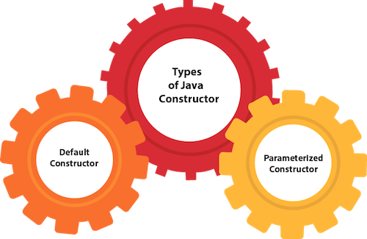
Types of Java Constructor
Java Constructors are of mainly two types:
Default Constructor
Parameterized Constructor

Slide 6
Default Constructor
A constructor is called “Default Constructor” when it doesn't have any parameter.
class Bike{
Bike(){
System.out.println("Bike is created");
}
public static void main(String args[]){
Bike b=new Bike();
}
}
purpose of a default constructor?
The default constructor is used to provide the default values to the object like 0, null, etc., depending on the type.

Slide 7
Automatic Default Constructor
If there is no constructor in a class, compiler automatically creates a default constructor.
class Student{
int id;
String name;
void display(){
System.out.println(id+" "+name);
}
public static void main(String args[]){
Student s1=new Student();
Student s2=new Student();
s1.display();
s2.display();
}
}
Output:
0 null
0 null

Slide 8
Parameterized Constructor
A constructor which has a specific number of parameters is called a parameterized constructor.
Why use the parameterized constructor?
The parameterized constructor is used to provide different values to distinct objects. However, you can provide the same values also.
class Student{
int id; String name;
Student(int i, String n){
id = i; name = n;
}
void display(){ System.out.println(id+" "+name); }
public static void main(String args[]) {
Student s1 = new Student(111,"Karan");
Student s2 = new Student(222,"Aryan");
s1.display();
s2.display();
}
}
Output:
111 Karan
222 Aryan

Slide 9
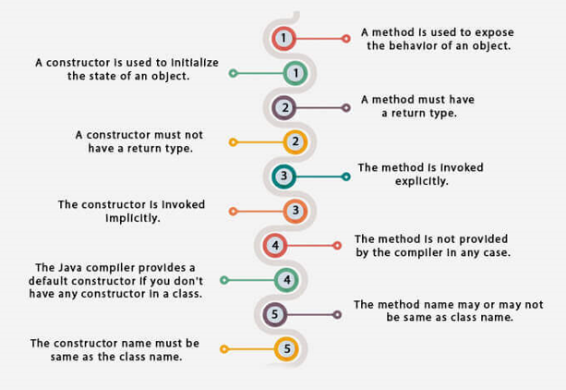
Constructor vs Methods

Slide 10
Constructor Overloading
Constructor overloading in Java is a technique of having more than one constructors with different parameter lists.
They are arranged in a way that each constructor performs a different task.
They are differentiated by the compiler by the number of parameters in the list and their types.
class Student{
int id; String name; int age;
Student(int i, String n){
id = i; name = n;
}
Student(int i, String n, int a){
id = i; name = n; age=a;
}
void display(){ System.out.println(id+" "+name+" "+age); }
public static void main(String args[]){
Student s1 = new Student(111,"Karan");
Student s2 = new Student(222,"Aryan",25);
s1.display();
s2.display(); }
}
Output:
111 Karan 0
222 Aryan 25

Slide 11
Copy Constructor
class Student{
int id; String name;
Student(int i, String n){
id = i; name = n;
}
Student(Student s){
id = s.id; name =s.name;
}
void display(){
System.out.println(id+" "+name);
}
public static void main(String args[]){
Student s1 = new Student(111,"Karan"); Student s2 = new Student(s1);
s1.display();
s2.display();
}
}
There is no default copy constructor in Java. However, we can copy the values from one object to another by explicitly defining copy constructor at the time of class design.
There are many ways to copy the values of one object into another in Java.
By copy constructor,
By assigning the values of one object into another,
By clone() method of Object class
Output: 111 Karan
111 Karan

Slide 12
Copying object without Copy Constructor
class Student{
int id; String name;
Student(int i, String n){
id = i; name = n; }
Student(){}
void display(){
System.out.println(id+" "+name);
}
public static void main(String args[]){
Student s1 = new Student(111,"Karan");
Student s2 = new Student();
s2.id=s1.id;
s2.name=s1.name;
s1.display();
s2.display();
}
}
class Student{
int id; String name;
Student(int i, String n){
id = i; name = n; }
void display(){
System.out.println(id+" "+name);
}
public static void main(String args[]){
Student s1 = new Student(111,"Karan");
Student s2 = (Student) s1.clone();
s1.display();
s2.display();
}
}
Output: 111 Karan
111 Karan
Output: 111 Karan
111 Karan

Slide 13
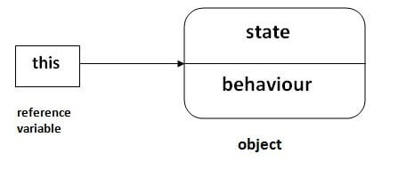
‘this’ keyword
In Java, ‘this’ is a reference variable that refers to the current object.
Usage of java this keyword:
this can be used to refer current class instance variable.
this can be used to invoke current class method (implicitly)
this() can be used to invoke current class constructor.
this can be passed as an argument in the method call.
this can be passed as argument in the constructor call.
this can be used to return the current class instance from the method.

Slide 14
this : to refer current class instance variable
class Student{
int rollno; String name;
Student(int rollno, String name){
rollno=rollno; name=name; }
void display(){
System.out.println(rollno+" "+name); }
}
class Test{
public static void main(String args[]){
Student s1=new Student(111, "Ankit");
Student s2=new Student(112, "Sumit");
s1.display();
s2.display();
}
}
Consider the following code where we have the class fields and the local variables with the same name.
Output: 0 null
0 null

Slide 15
this : to refer current class instance variable
class Student{
int rollno; String name;
Student(int rollno, String name){
this.rollno=rollno;
this.name=name; }
void display(){
System.out.println(this.rollno+" "+
this.name); }
}
class Test {
public static void main(String args[]){
Student s1=new Student(111, "Ankit");
Student s2=new Student(112, "Sumit");
s1.display();
s2.display();
}
}
class Student{
int rollno; String name;
Student(int r, String n){
rollno=r;
name=n; }
void display(){
System.out.println(rollno+" "+name); }
}
class Test{
public static void main(String args[]){
Student s1=new Student(111, "Ankit");
Student s2=new Student(112, "Sumit");
s1.display();
s2.display();
}
}
Output: 111 Ankit
112 Sumit
Output: 111 Ankit
112 Sumit

Slide 16
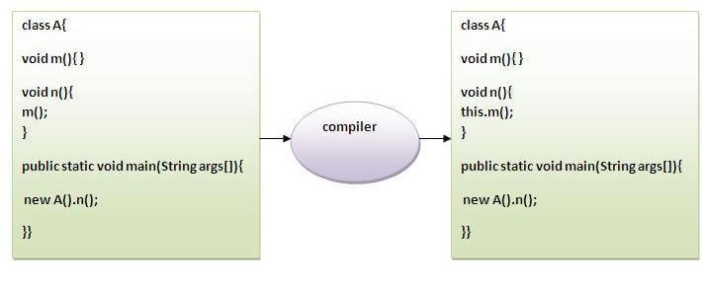
this: to invoke current class method
You may invoke the method of the current class by using this keyword.
If you don't use this keyword, compiler automatically adds this keyword while invoking the method.

Slide 17
this(): to invoke current class constructor
The this() constructor call can be used to invoke the current class constructor. It is used to reuse the constructor. In other words, it is used for constructor chaining.
Calling default constructor from parameterized constructor:
class A{
A(){System.out.println("hello a");}
A(int x){
this();
System.out.println(x); }
}
class Test{
public static void main(String args[]){
A a=new A(10);
}
}
Output:
hello a
10

Slide 18
this(): to invoke current class constructor
The this() constructor call can be used to invoke the current class constructor. It is used to reuse the constructor. In other words, it is used for constructor chaining.
Calling parameterized constructor from default constructor:
class A{
A(){
this(10);
System.out.println("hello a");
}
A(int x){ System.out.println(x); }
}
class Test{
public static void main(String args[]){
A a=new A();
}
}
Output:
10
hello a

Slide 19
this(): constructor chaining
class Student{
int rollno; String name, course; float fee;
Student(int rollno, String name, String course){
this.rollno=rollno; this.name=name; this.course=course; }
Student(int rollno, String name, String course, float fee){
this(rollno, name, course); //reusing constructor
this.fee=fee; }
void display(){ System.out.println(rollno+" "+name+" "+course+" "+fee); }
}
class Test {
public static void main(String args[]){
Student s1=new Student(111,"ankit","java");
Student s2=new Student(112,"sumit","python",6000f);
s1.display();
s2.display(); }
}
Output: 111 ankit java 0.0
112 sumit python 6000.0

Slide 20
this: as argument in the method call
class Student{
void read(Student st){
System.out.println("Student is reading");
}
void study(){
read(this);
}
public static void main(String args[]){
Student s = new Student();
s.study();
}
}
Output:
Student is reading

Slide 21
this: as argument in the constructor call
class Course {
Student obj;
Course(Student s){ this.obj=s; }
void display(){ System.out.println(obj.id+" "+obj.name); }
}
class Student{
int id=5000; String name="Subhash";
Student(){
Course c=new Course(this); c.display();
}
public static void main(String args[]){
Student s = new Student();
}
}
Output:
5000 Subhash

Slide 22
this: to return current class instance
class Student{
int id; String name;
Student setStudentData(int x, String n){
id=x; name=n;
return this;
}
void display(){System.out.println(id+" "+name);}
}
class Test{
public static void main(String args[]){
Student obj = new Student();
obj = obj.setStudentData(111,"ankit");
obj.display();
}
}
Output:
111 ankit
Notes:
Note: private and protected access modifiers apply only to members not to the classes or interfaces themselves (unless nested).

Slide 23
Summary
Today, we learned about
Constructors in Java (default, parameterized)
Method vs Constructors
Copy Constructors in Java
Constructor Overloading
‘this’ keyword and its several usage

Slide 24


